Slide 1

DWD220 Pitch
Gary Lam Ka Fung
Madeliene Edward

Slide 2
Band info
Four piece metal band
Brisbane Band
Member
Jake Whitney
Elijah “Eli” Sapolu
Jack “Budgy” Mathews
Jack Dowie
Facebook https://www.facebook.com/pg/Aramatband/about/?ref=page_internal
IG https://www.instagram.com/aramat.au/
Spotify https://open.spotify.com/artist/37Mn5YK8so1CkMUiurQGcc?si=o4ryHKbKTwWcs5SuIr-qog
…

Slide 3
Goal: Making a website to get more audience, make connection and create opportunities.
Deliver: create new theme on wordpress.

Slide 4
S W O T
Strengths | Weakness
The Band have a good fanbase. And are very active in Brisbane. Lyrics with deep meaning | Tight community Limited information that is uploaded online
Opportunities | Threats
Huge room to improve | Lot of similar bands in Brisbane

Slide 5



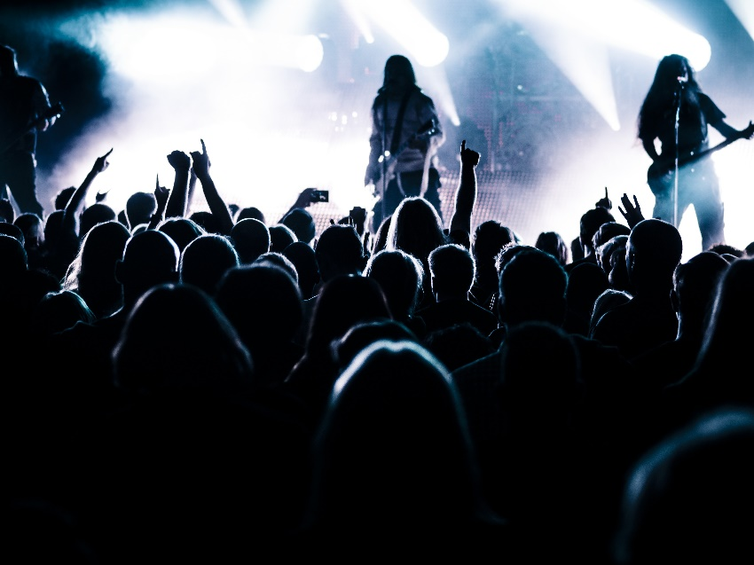
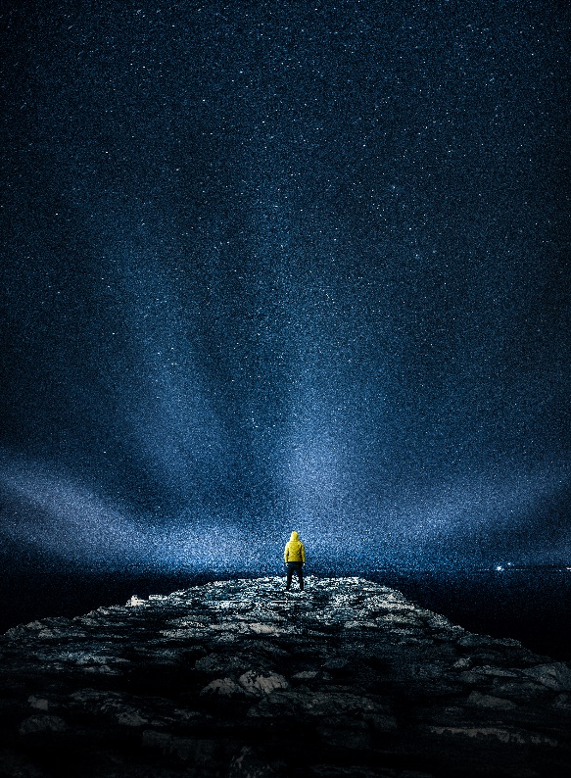

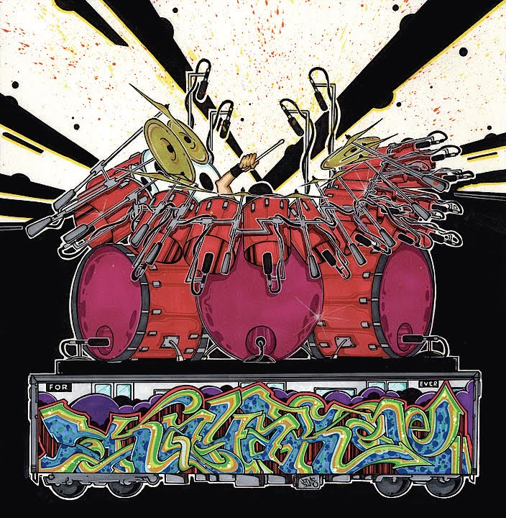
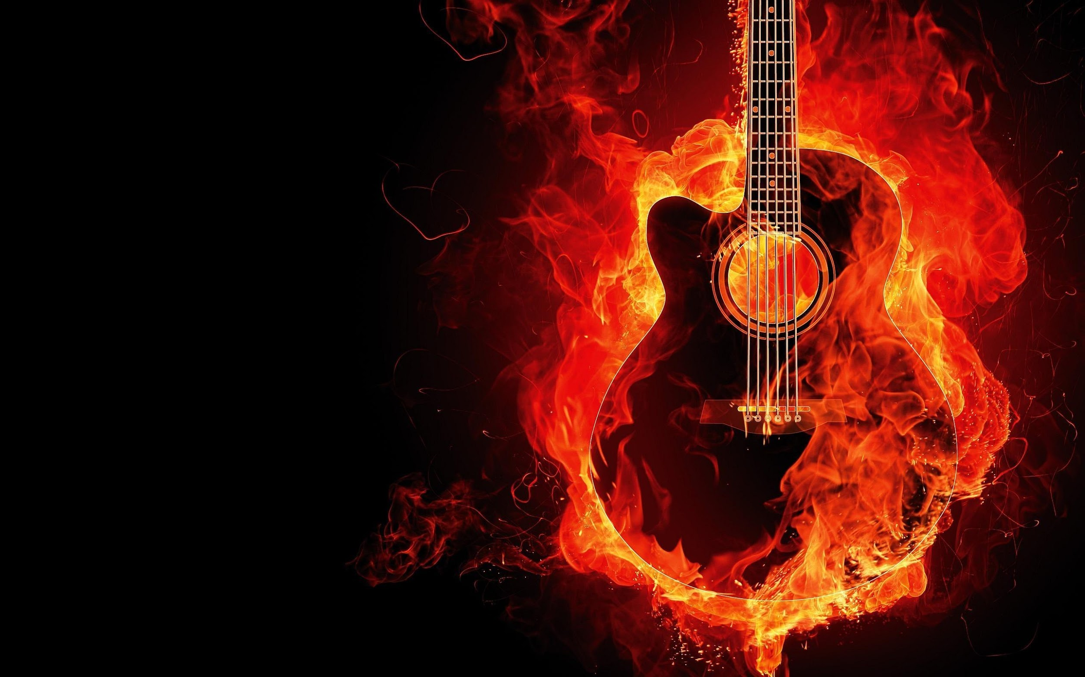
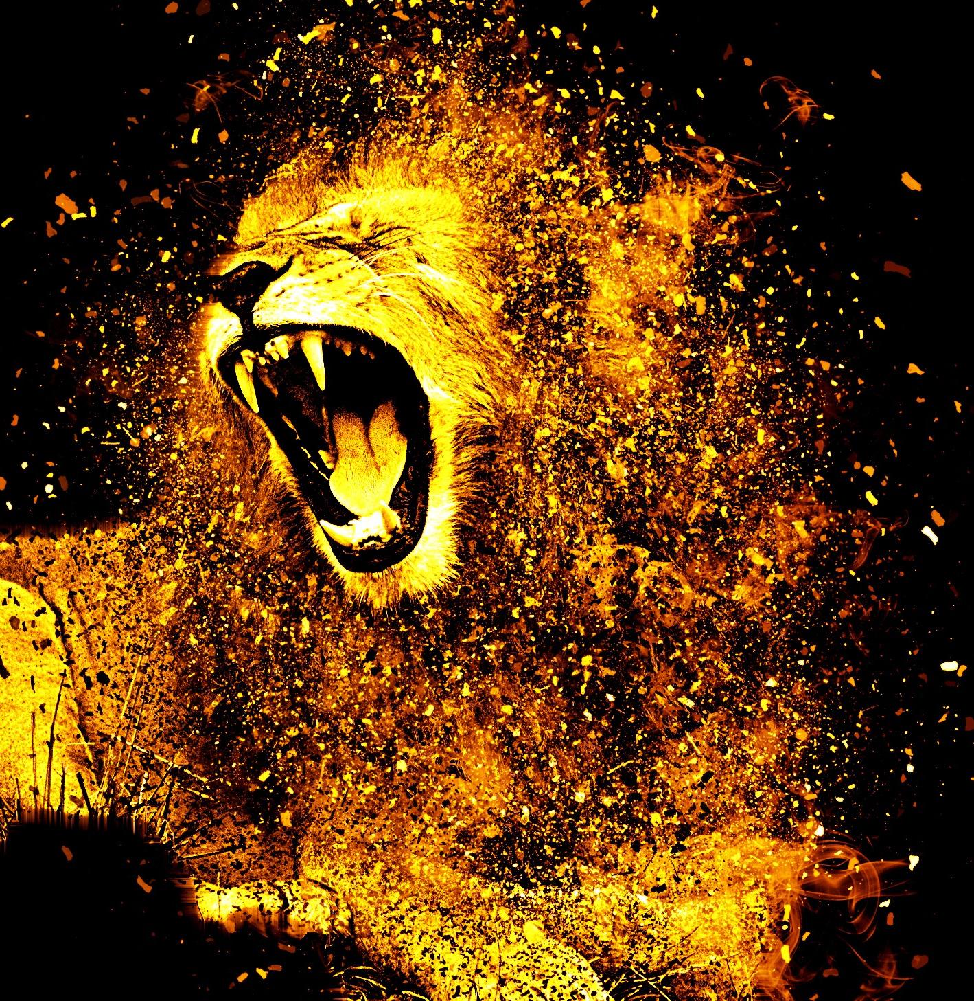
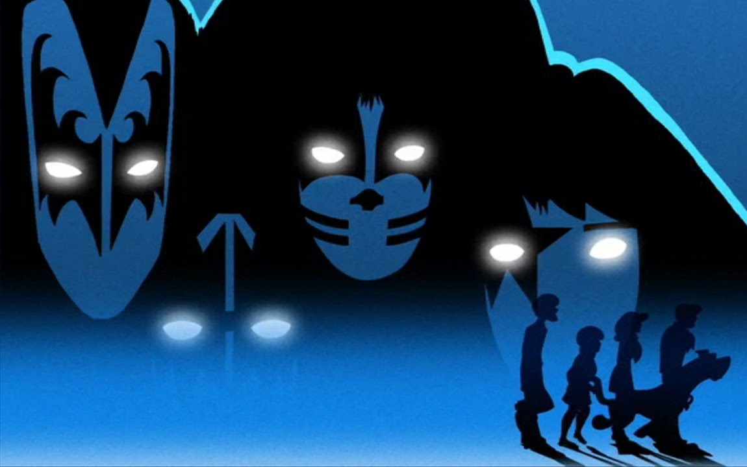
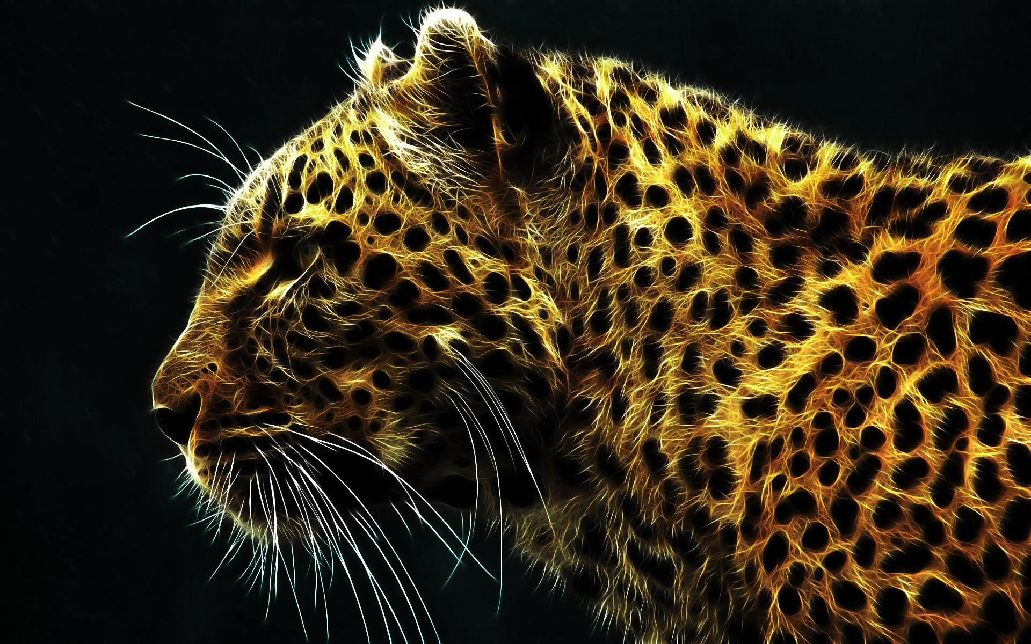
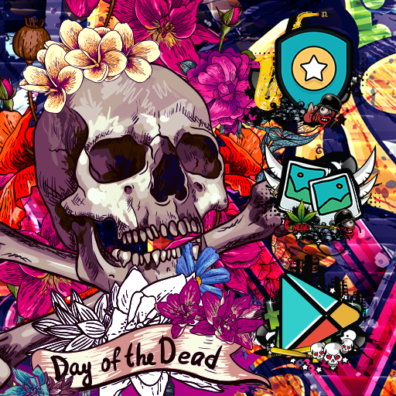
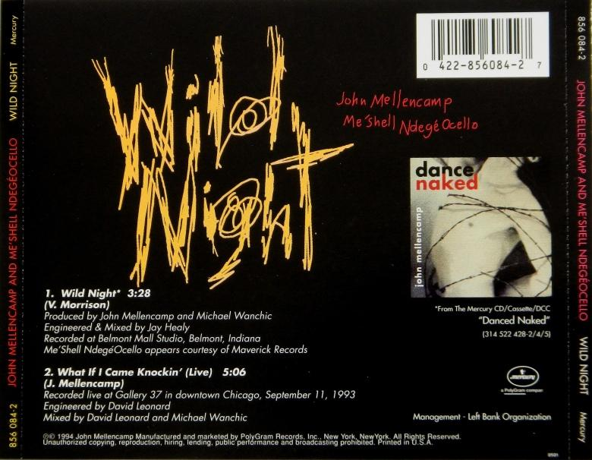
MOOD BOARD

Slide 6
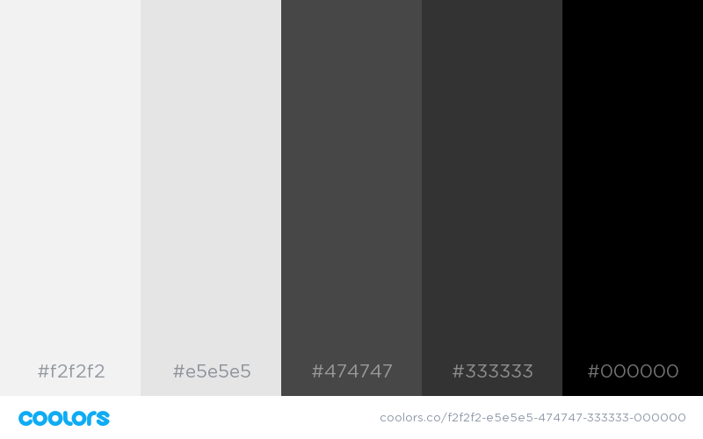
COLOR SCHEME

Slide 7

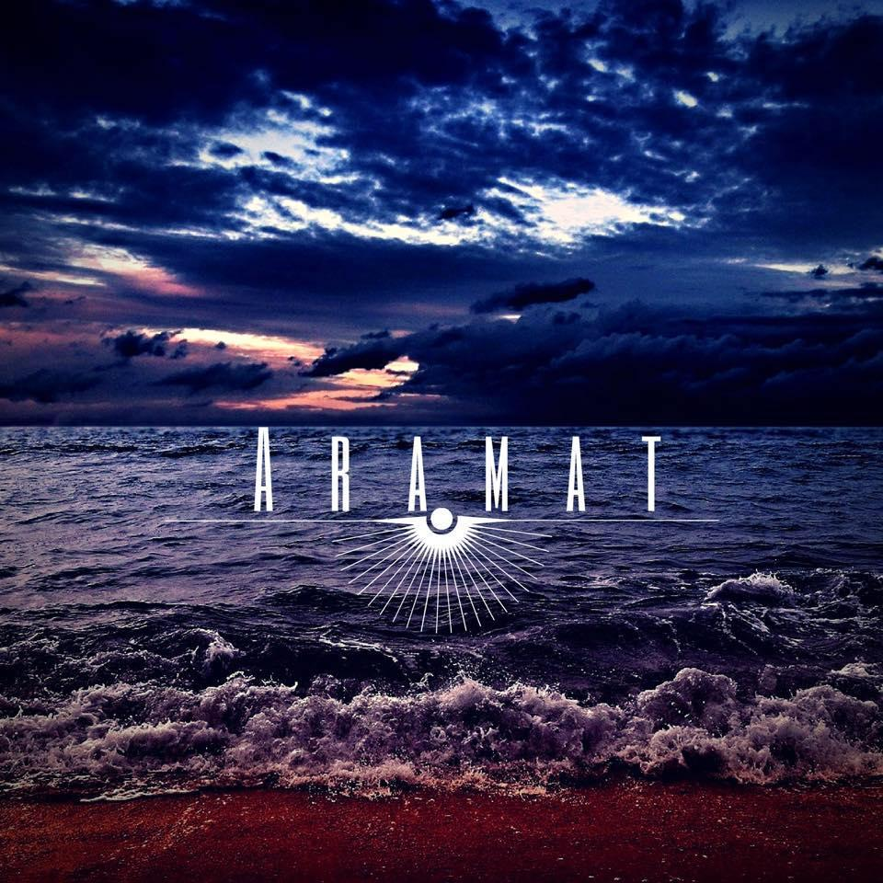

ICON

Slide 8
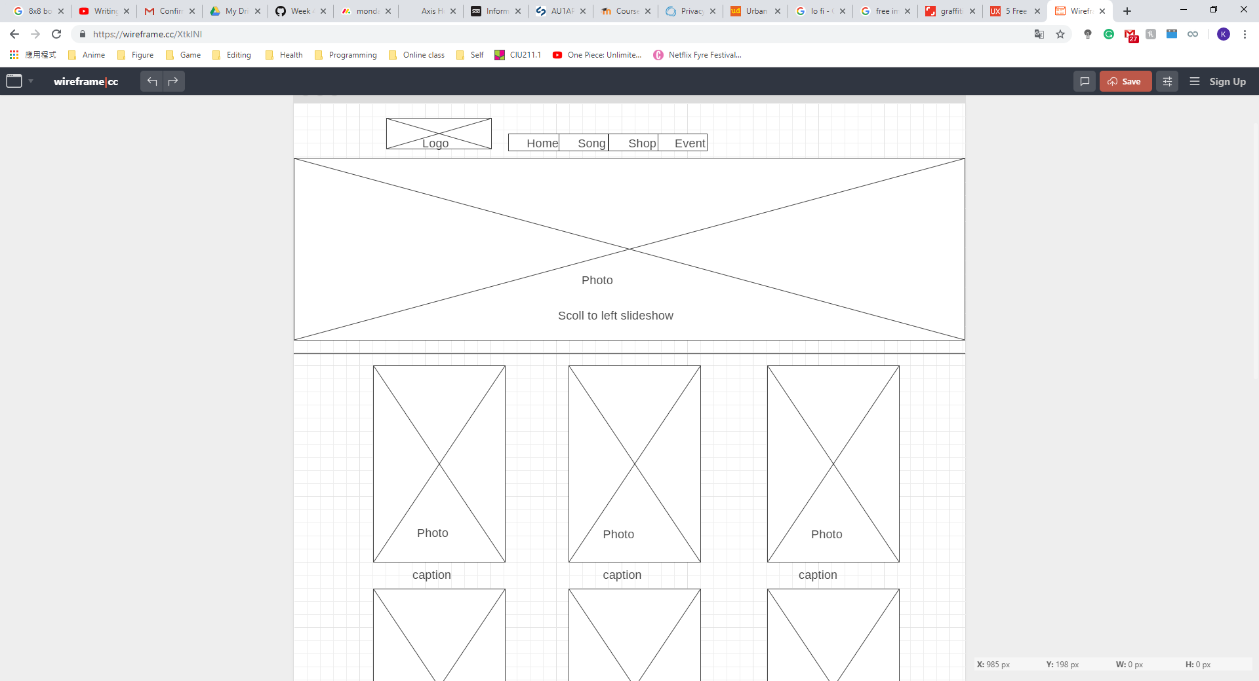
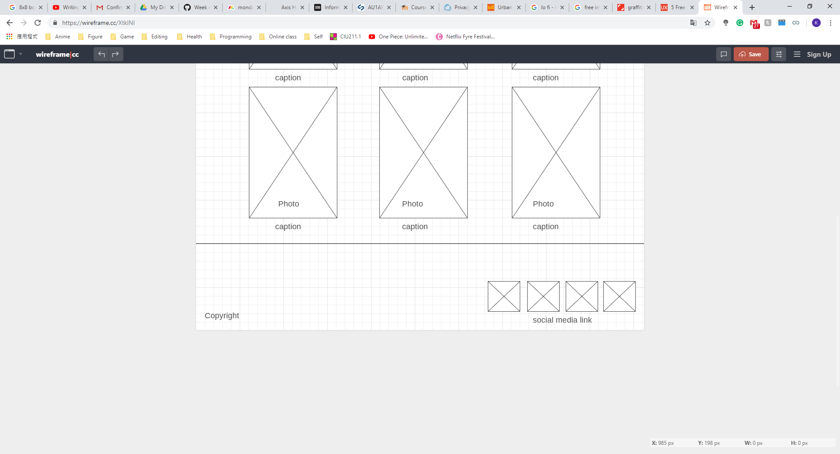
LAYOUT

Slide 9
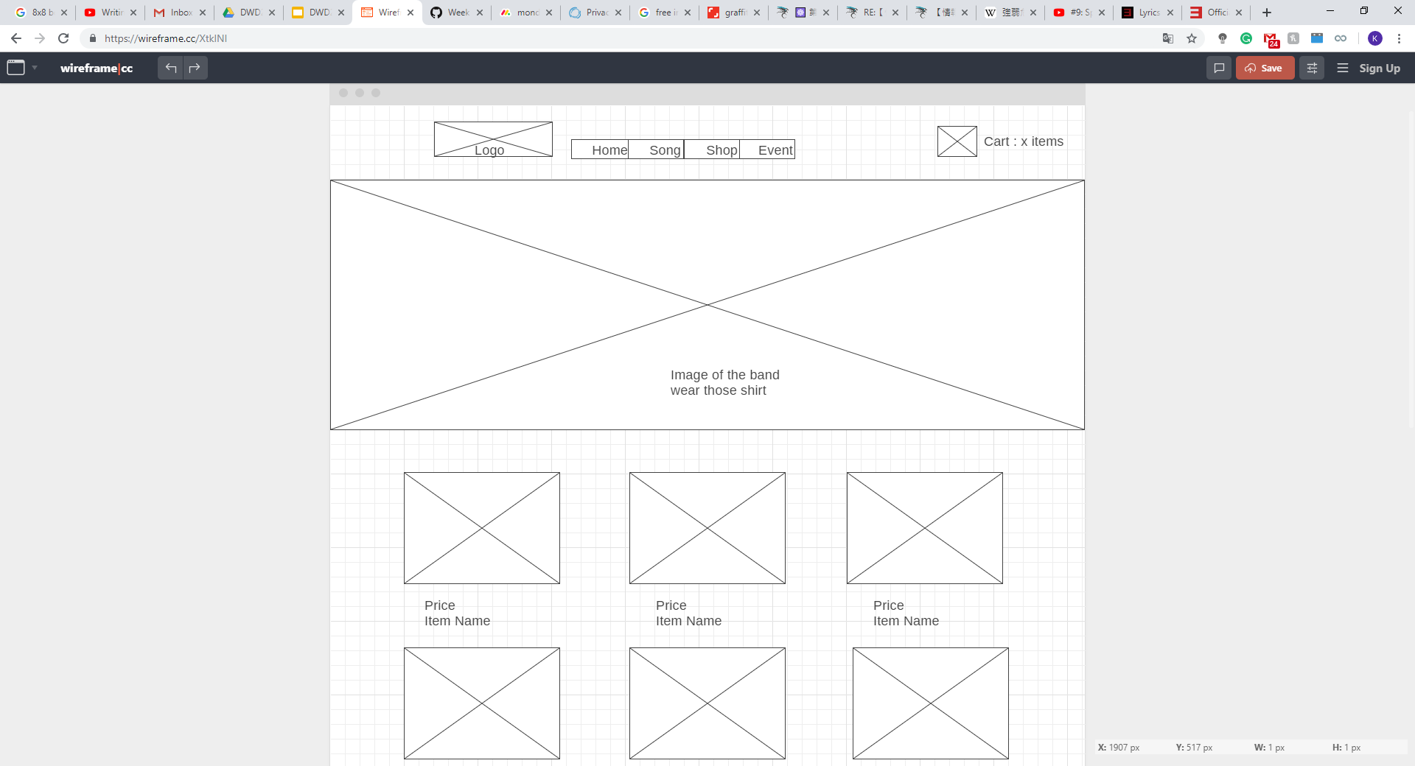
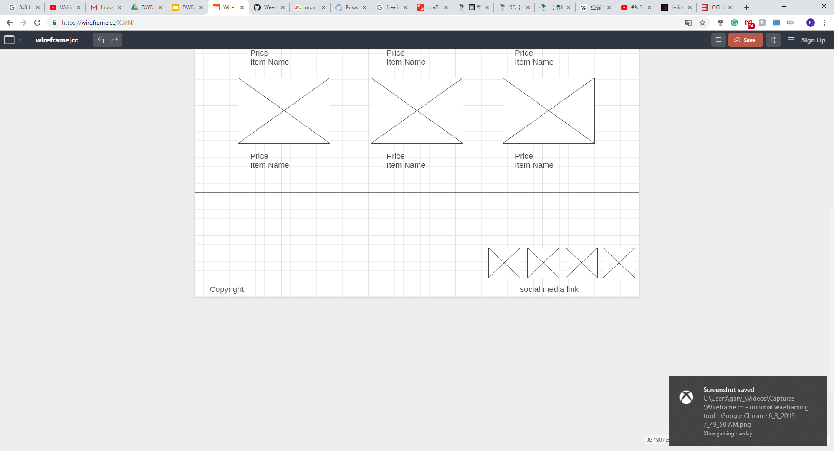

Slide 10
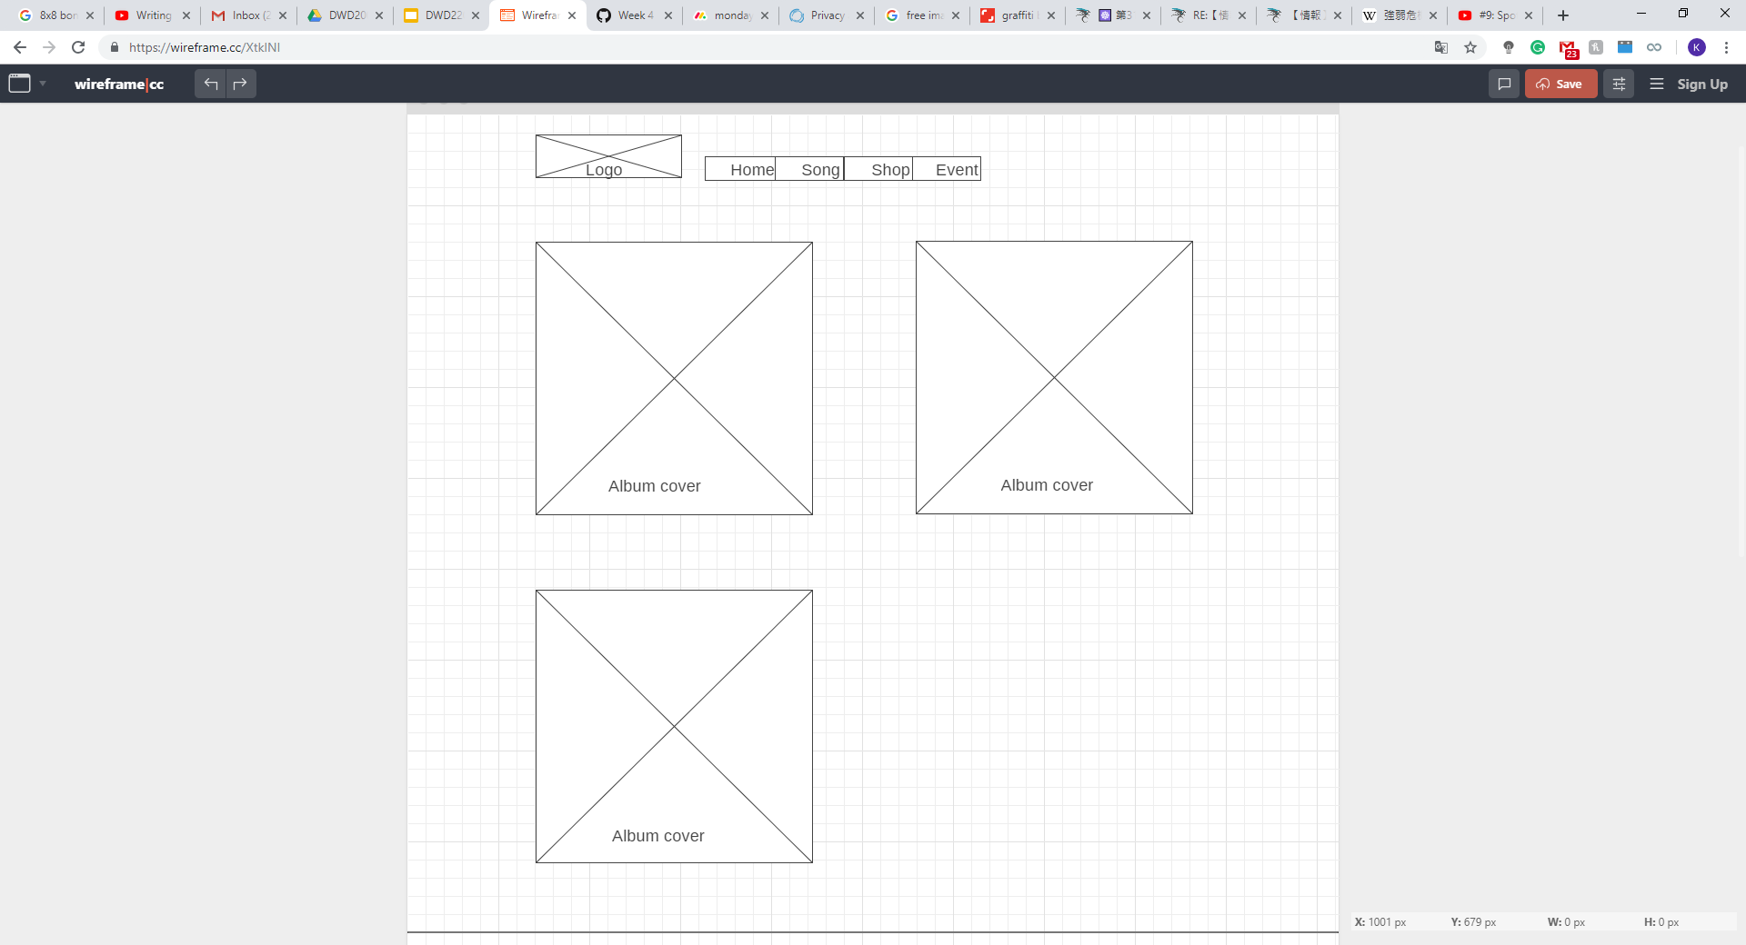
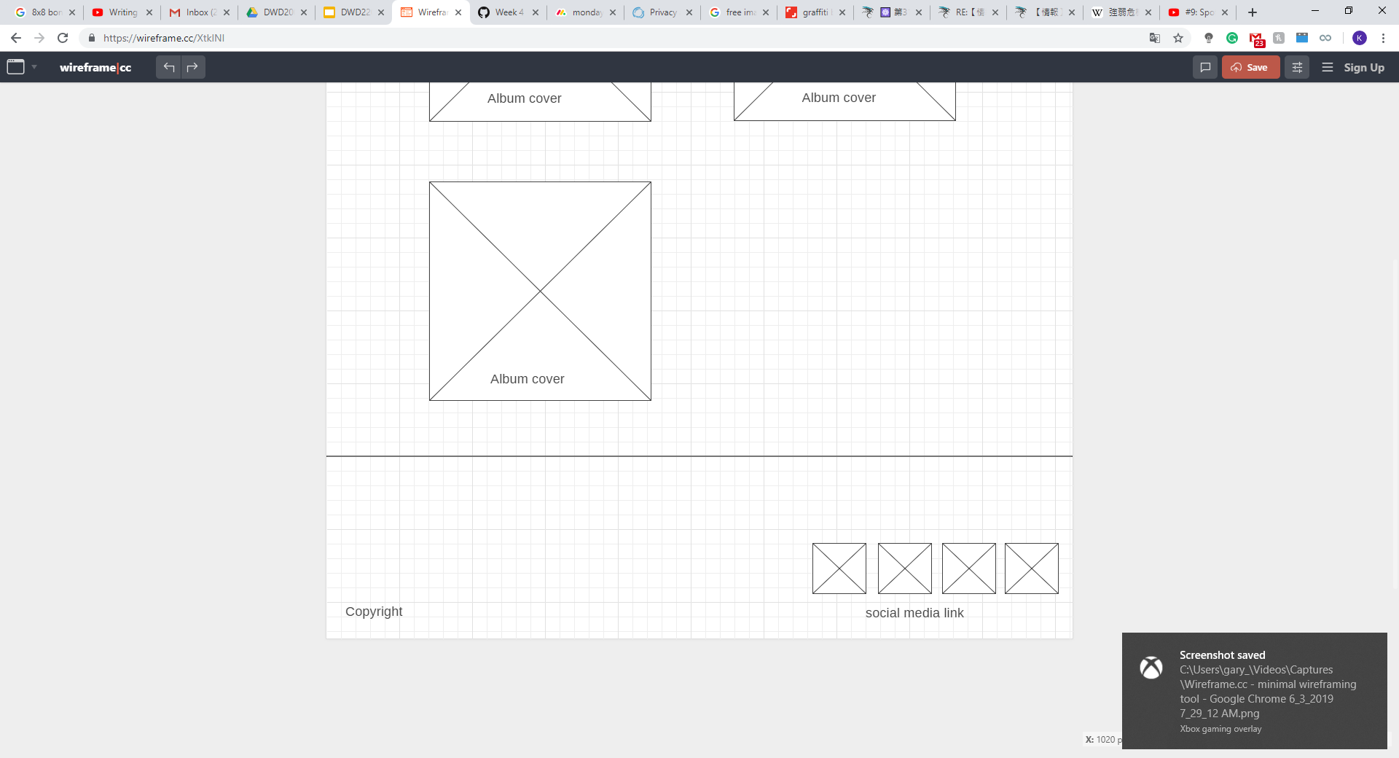

Slide 11
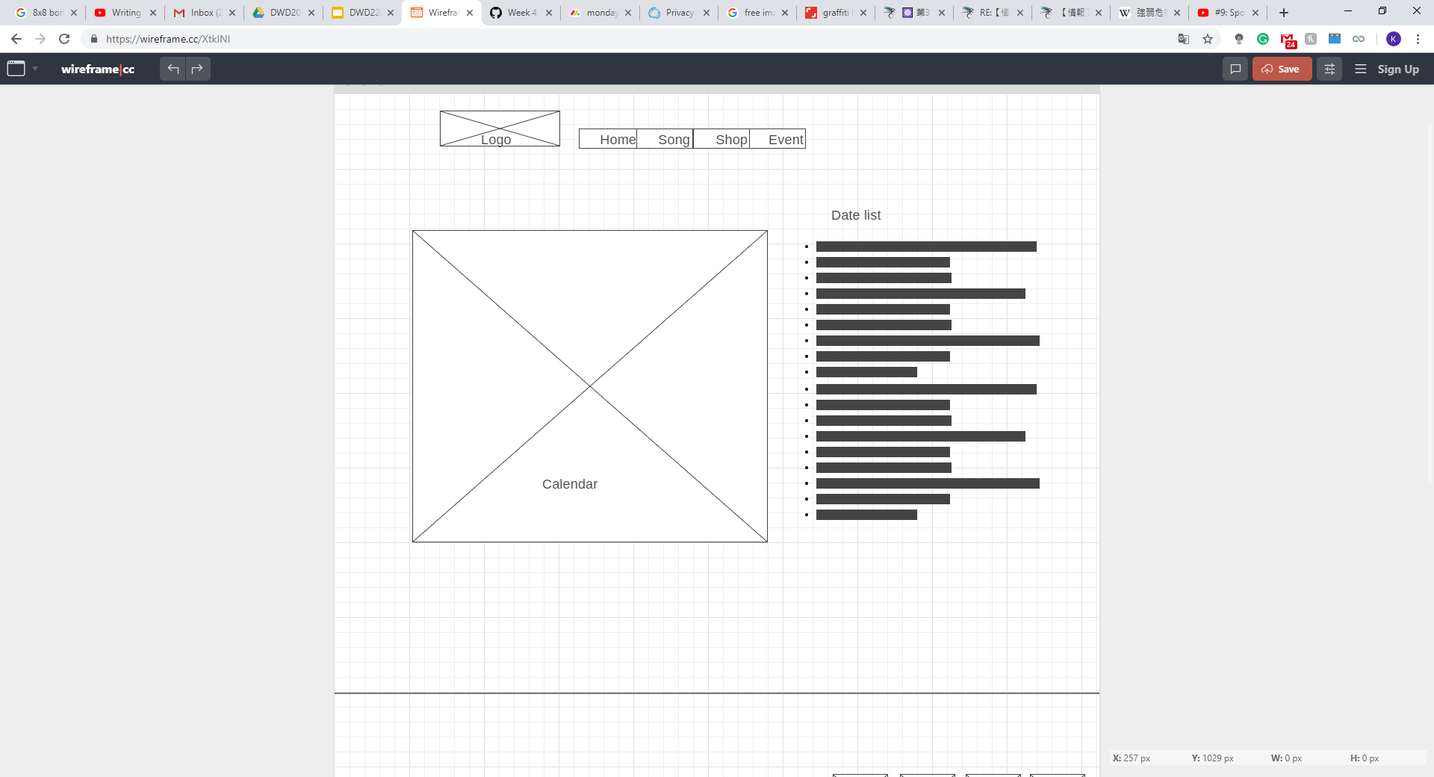
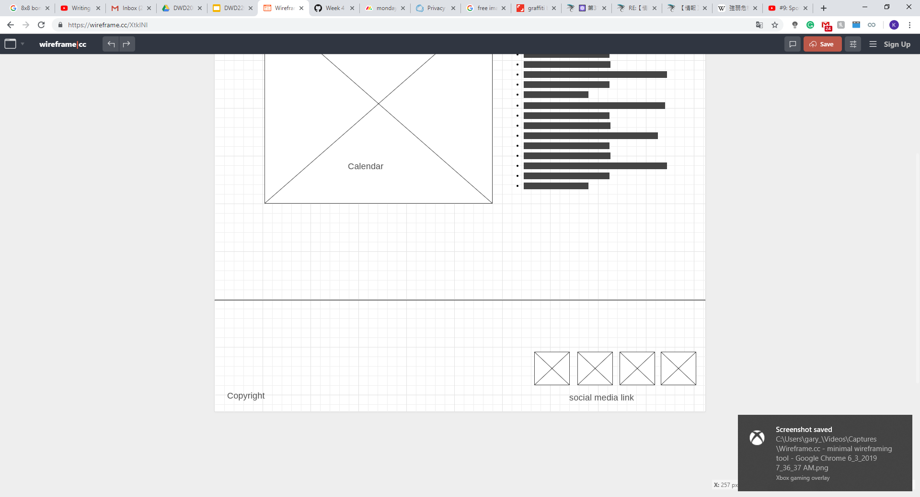

Slide 12
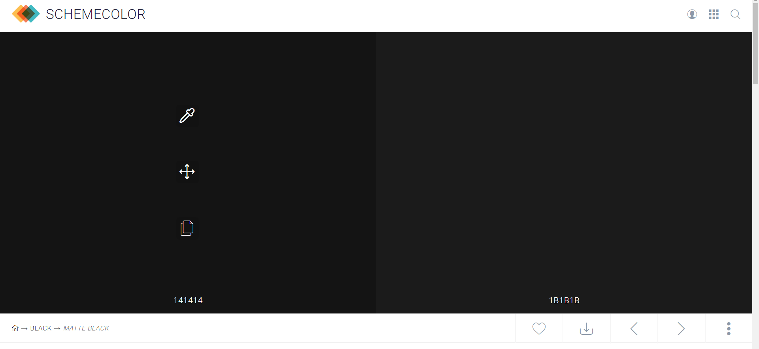
BACKGROUND TEXTURE
Matte Black as the Background

Slide 13
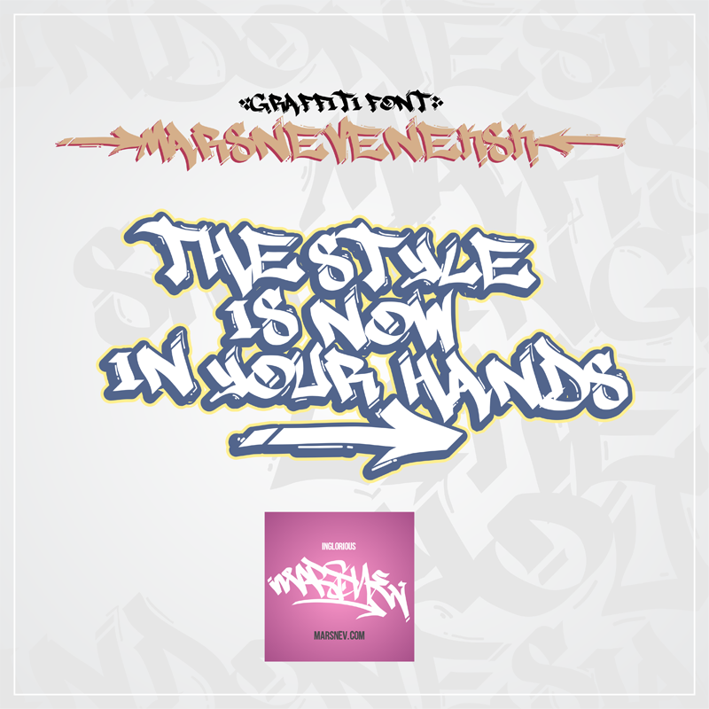
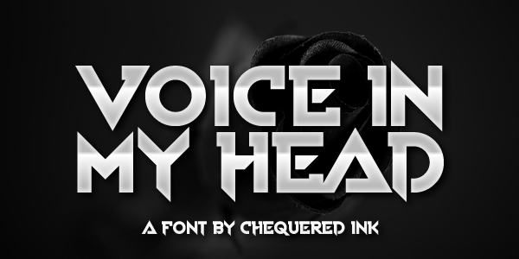
FONT
Marsneveneksk
Voice In My Head

Slide 14
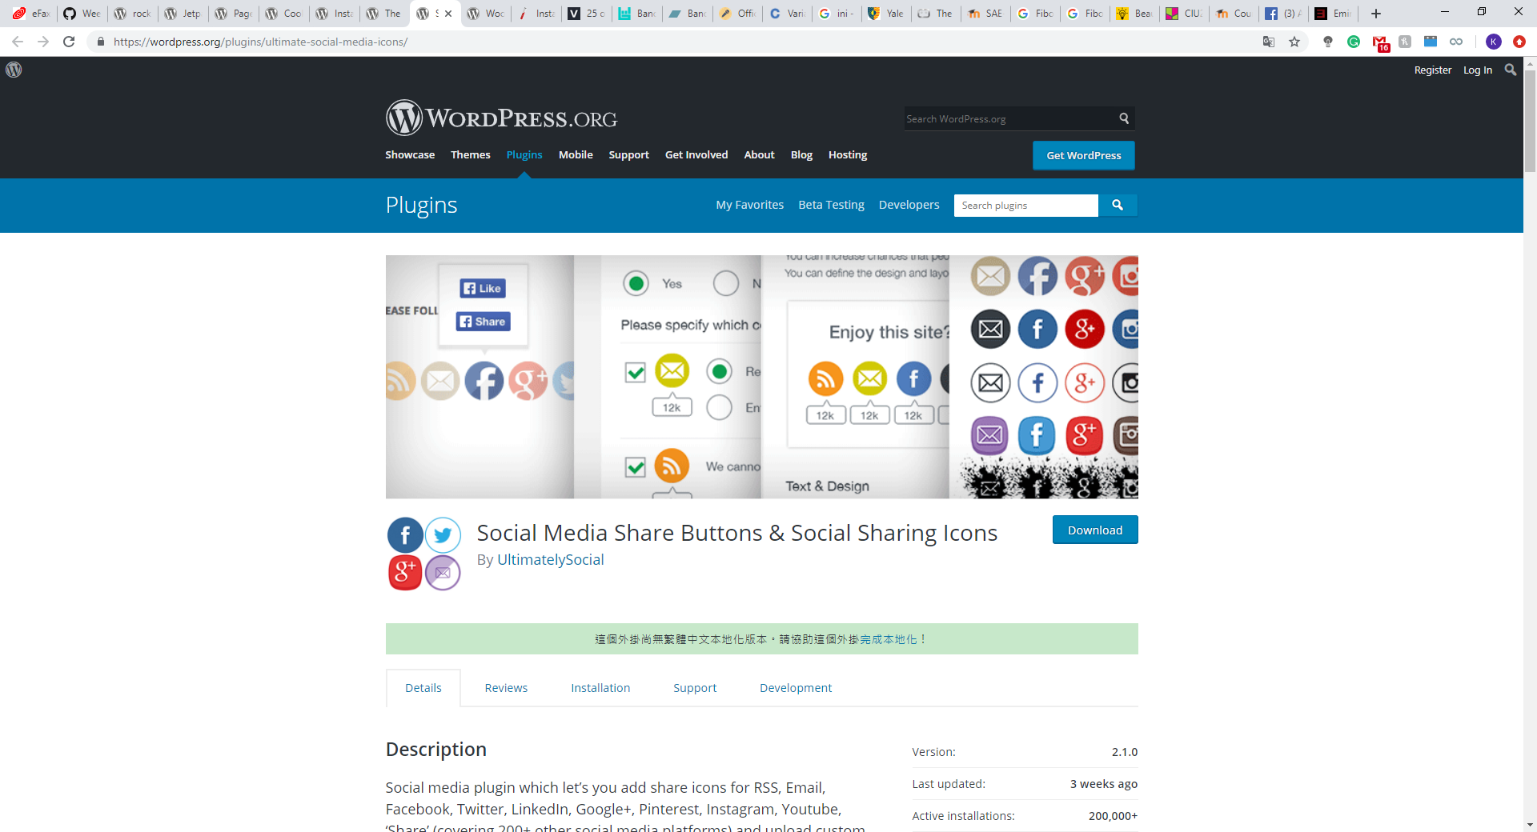
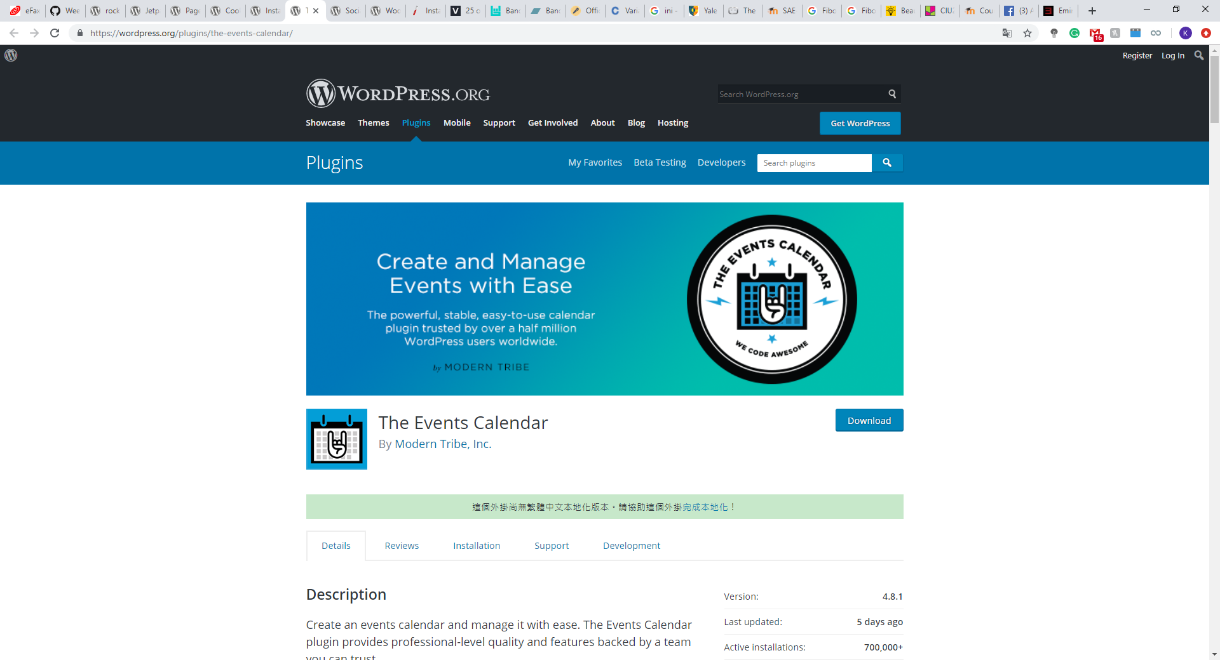
OTHER ELEMENTS (SOCIAL MEDIA ICON/ CALENDAR)

Slide 15
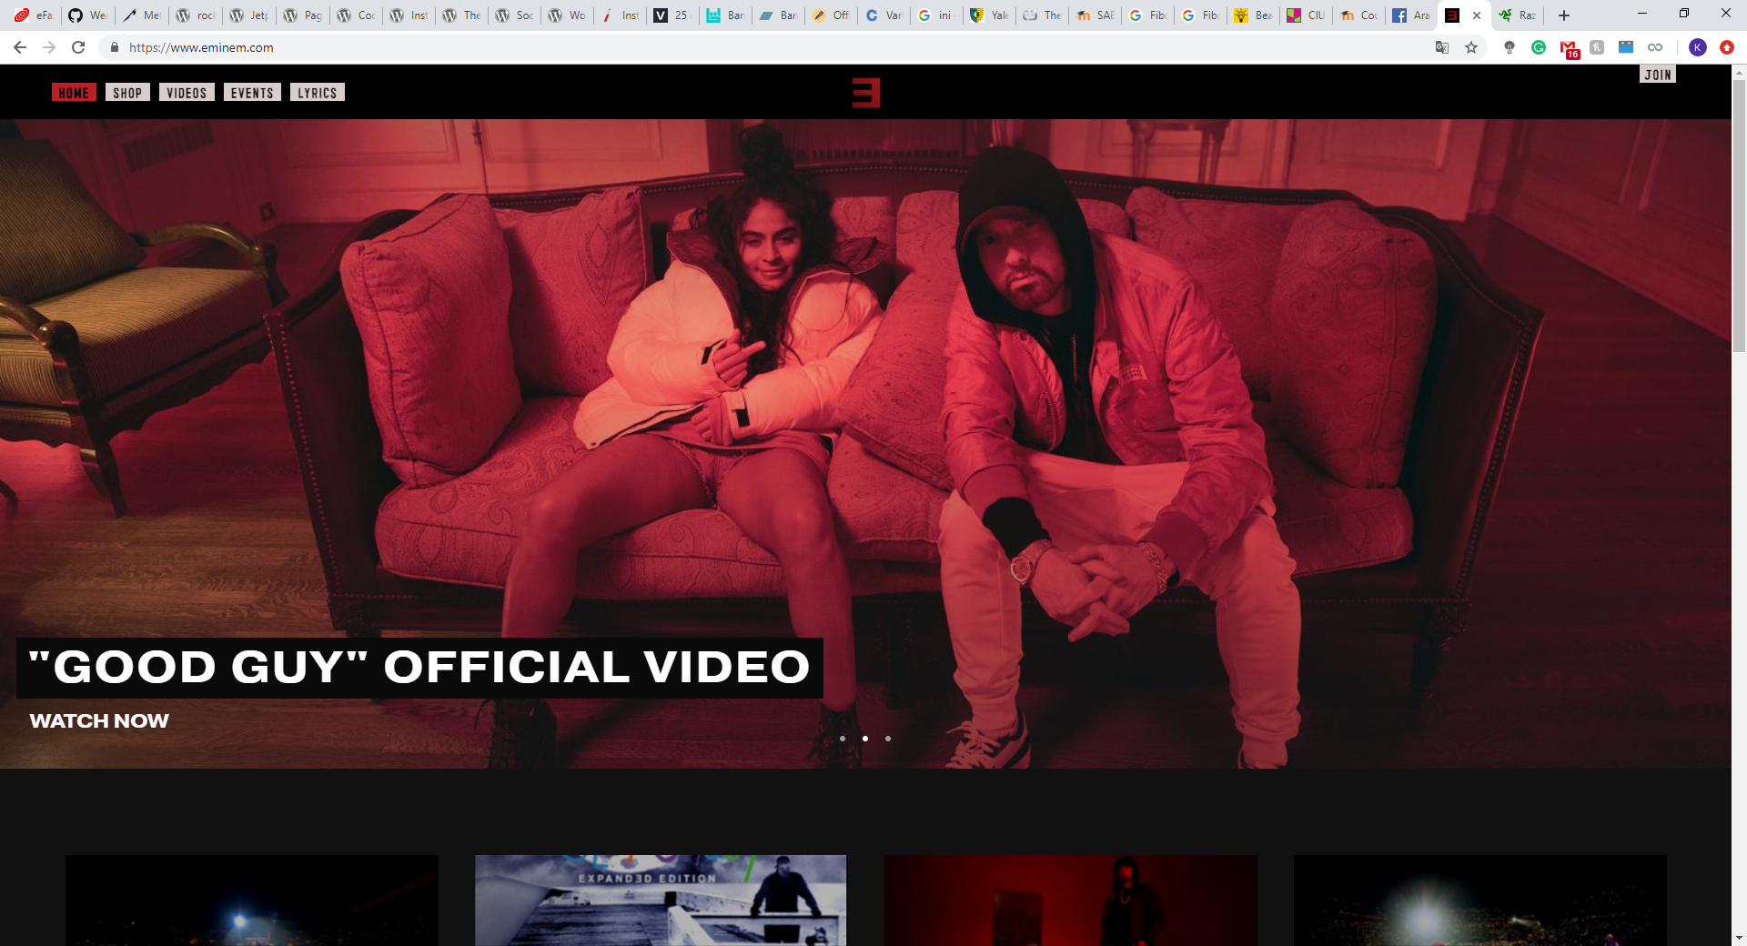
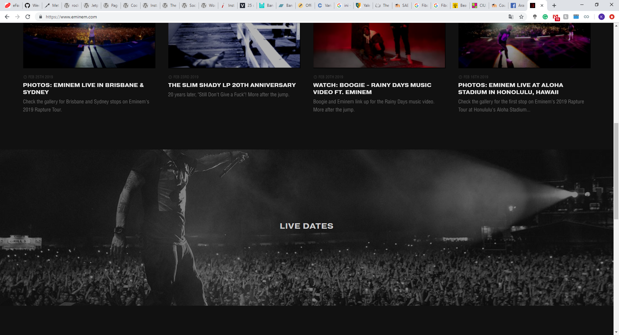
INSPIRATION

Slide 16
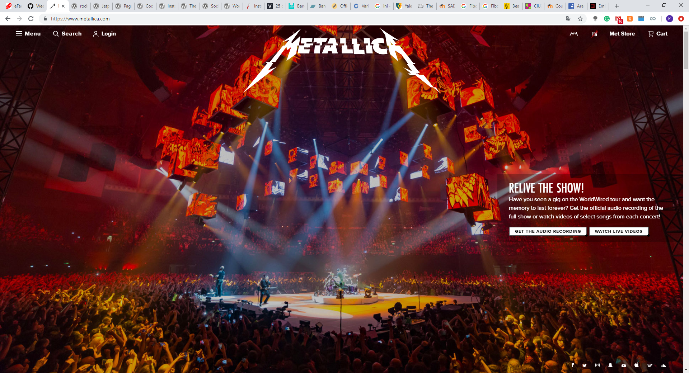
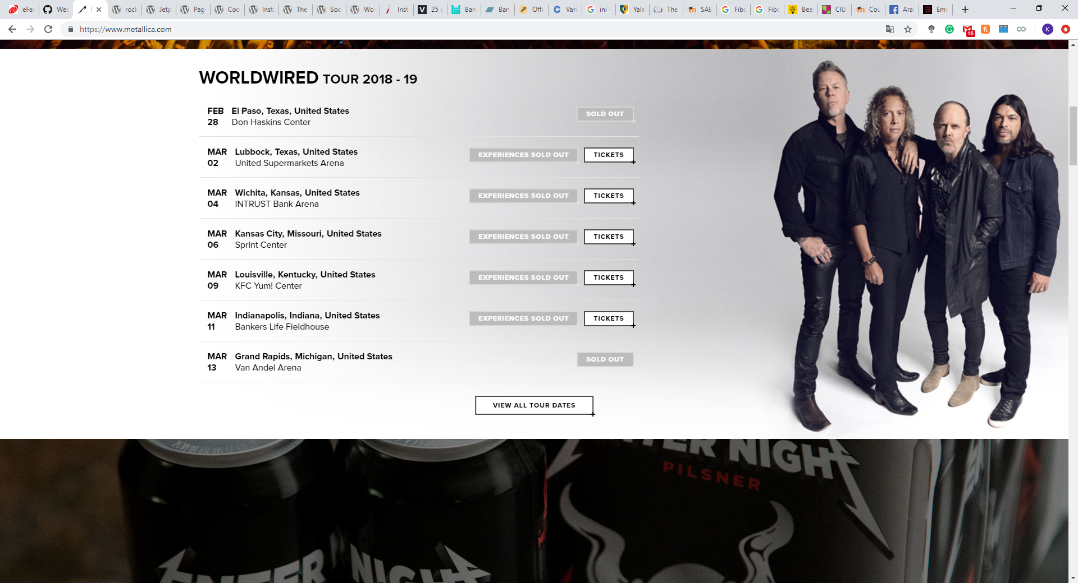

Slide 17
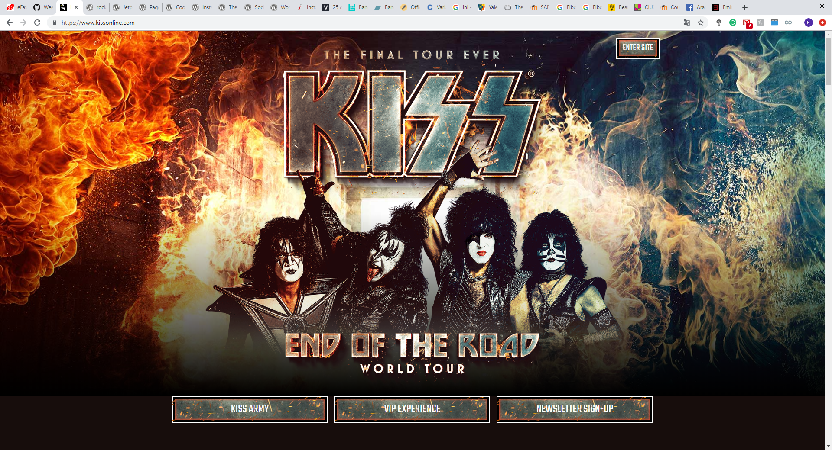
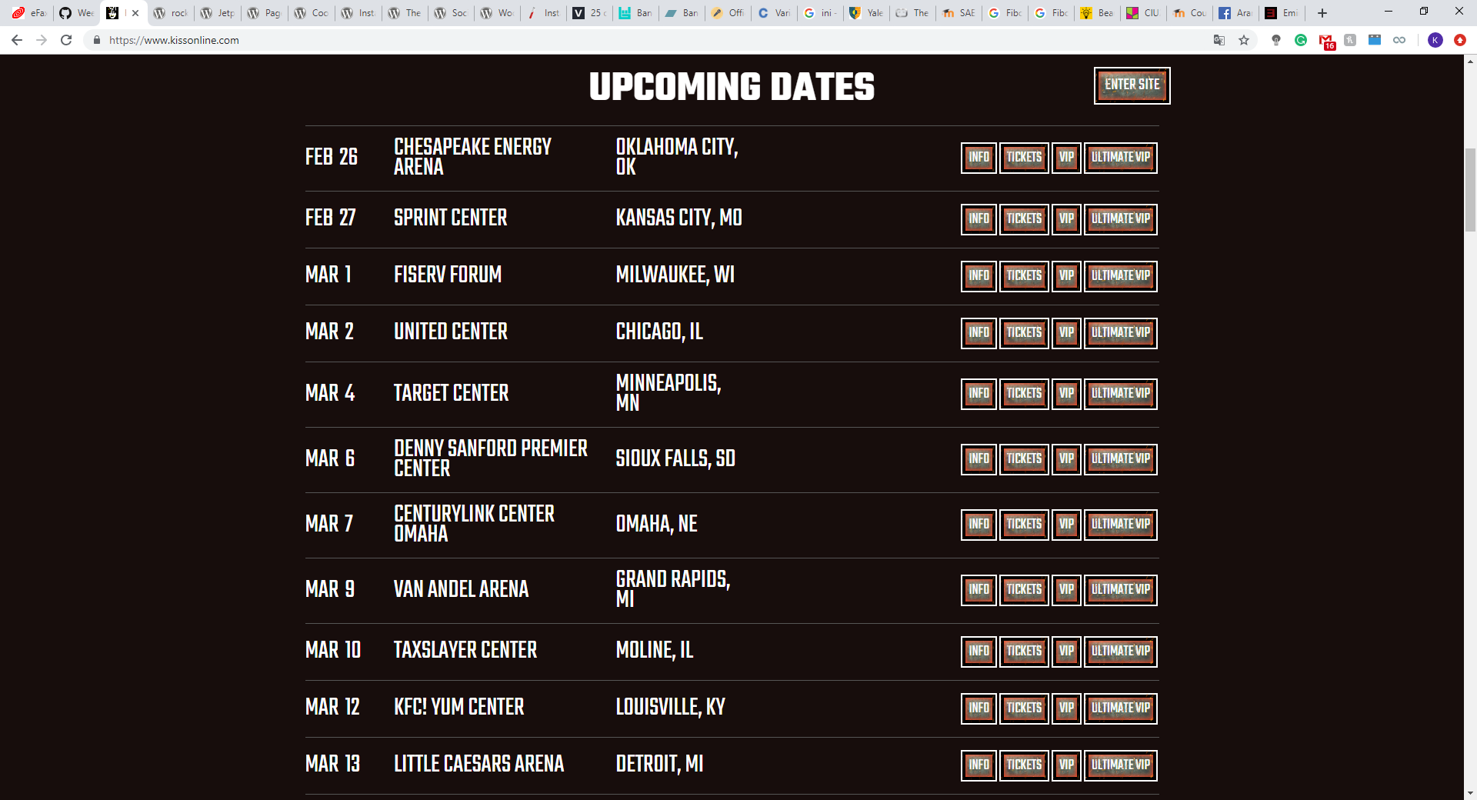

Slide 18
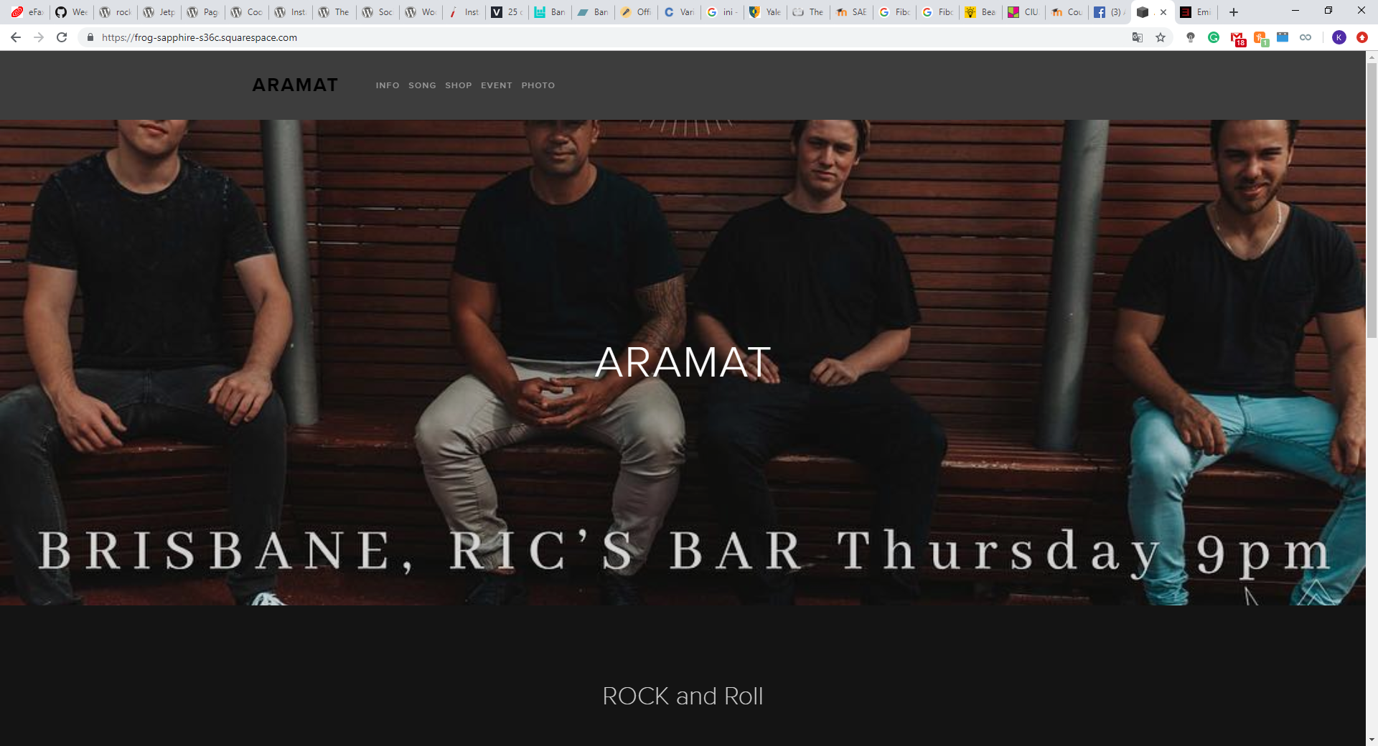
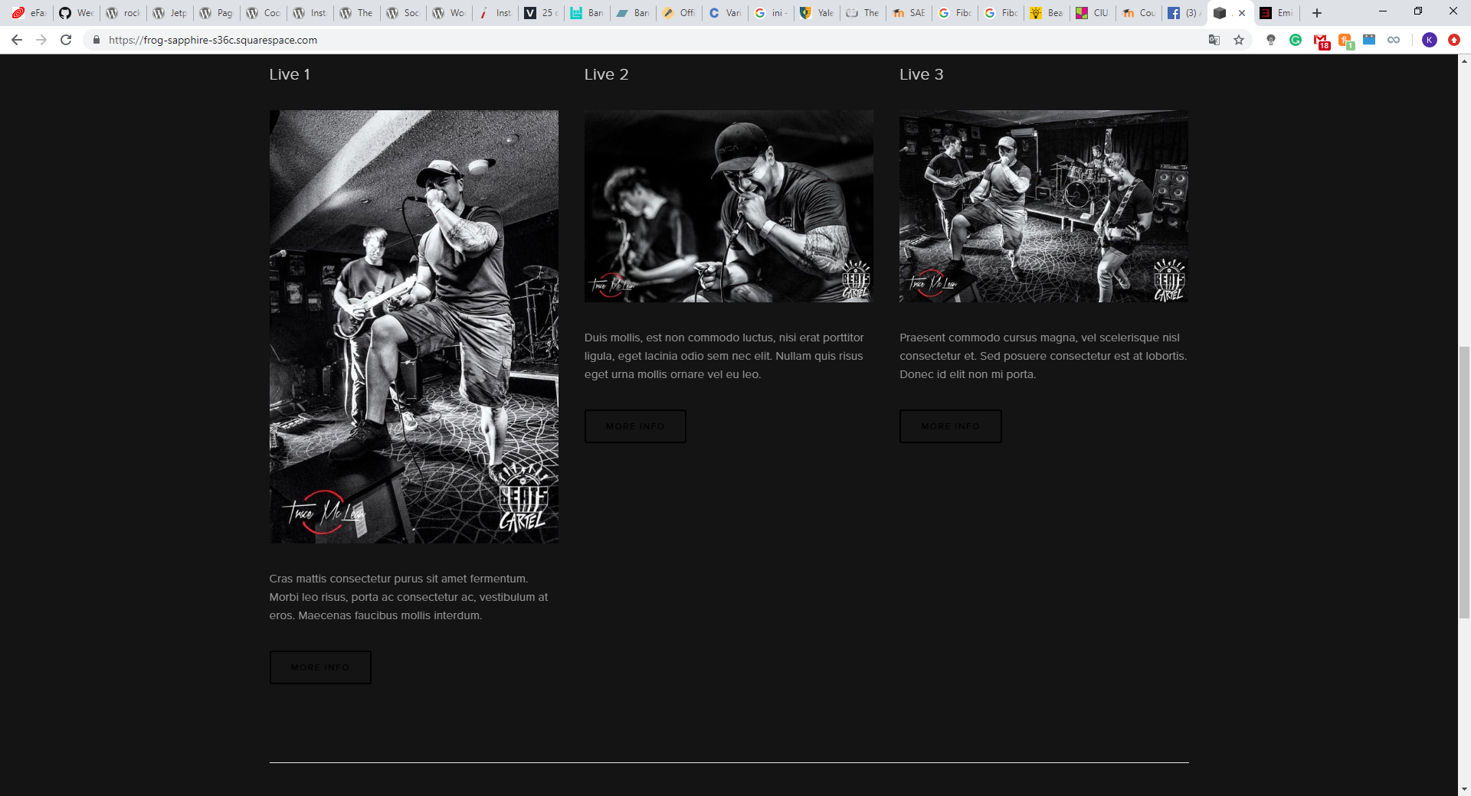
MOCKUP

Slide 19
REF
https://www.facebook.com/Aramatband/
https://coolors.co/
https://wireframe.cc
https://wordpress.org/plugins/ultimate-social-media-icons/
https://wordpress.org/plugins/the-events-calendar/
https://www.eminem.com/
https://www.kissonline.com/
https://www.metallica.com/
https://www.dafont.com/marsneveneksk.font
https://www.dafont.com/voice-in-my-head.font
https://frog-sapphire-s36c.squarespace.com/

